Slide 1


SDP
LECTURE
The Observer Design Pattern
Software Design Patterns
Diploma in IT
Year 2 (2024/25), Semester 4
4.1
Notes:
Hi everyone, this week we will be looking at 2 more design patterns. The first one is called the Observer pattern. Let’s see how this one works.

Slide 2
Example Problem – Weather Station
Weather-O-Rama, Inc., is an Internet-based weather monitoring station
They are hiring you to create an application with 3 real-time display elements:
Current conditions
Weather statistics
Simple forecast
You are provided with a WeatherData object that is updated whenever the weather data changes
Notes:
Let’s take a look at the example of a weather station. Weather-O-Rama is a company that runs a weather station containing a whole bunch of sensors that measures things like temperature, pressure and humidity, and all these measurements are available on the Internet. Now, they want you to build an application that has 3 displays that updates their information in real time. The 3 displays are current conditions, weather statistics and a simple forecast, and the information shown in each display is calculated based on the information provided by the sensors. You are provided with a || WeatherData object that allows you to retrieve the sensor information, and it is updated whenever the weather data changes. So if the temperature does up by 0.1 degrees, the WeatherData object will be updated accordingly.

Slide 3
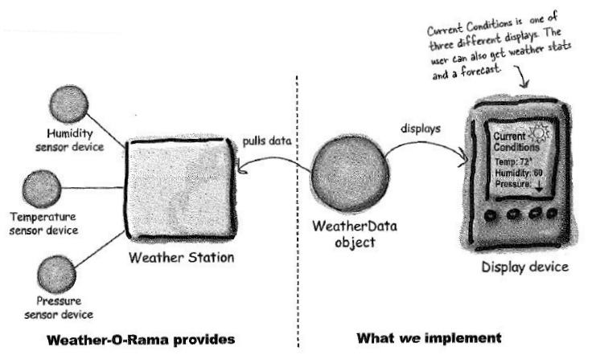
Example Problem – Weather Station
Image from Eric Freeman and Elisabeth Freeman, “Head First Design Patterns”, O’Reilly, 2004
Notes:
Here is a graphical representation of the problem. Weather-O-Rama controls the || weather station that has a bunch of sensors. We need to implement two things. Firstly, we must implement a || WeatherData object that pulls data from the weather station. Secondly, we need to take the data from the WeatherData object and || implement 3 displays. This picture shows the Current Conditions display, but there are 2 other displays that we currently need to create. Sounds good? OK, let’s start.

Slide 4
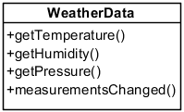
The WeatherData Class
// This method gets called whenever the weather
// measurements have been updated
public void measurementsChanged() {
// your code goes here
}
Notes:
First, let’s look at the WeatherData class. The weather station has a whole bunch of high-tech sensors that may include complex algorithms and their own API’s. In this version, we start with only temperature, humidity and barometric pressure, although there may be more sensors involved in the future. Our WeatherData class therefore has || 3 getter methods that return the most recent weather measurements for temperature, humidity and barometric pressure, respectively, that are provided by Weather-O-Rama.
Our main job is to implement a || measurementsChanged() method, which is called whenever the weather measurements change and updates our three displays for current conditions, weather statistics and forecast. So every time there is a change in any reading, measurementsChanged() will be called to update our displays.

Slide 5
First Attempt
What do you think of this design?
class WeatherData {
public void measurementsChanged() {
double temp = getTemperature();
double hum = getHumidity();
double pres = getPressure();
currCondDisplay.update(temp, hum, pres);
statsDisplay.update(temp, hum, pres);
forecastDisplay.update(temp, hum, pres);
}
}
Area of change, we
should encapsulate this
We are coding to
concrete implementations!
Notes:
So, how do we implement measurementsChanged()? Well, we know that whenever it is called, at least one of the temperature, pressure and humidity values has changed, so we need to first call all the getters to get the latest values for temperature, humidity and pressure. After that, we can just call the update methods for our 3 displays with these latest values. So, what do you think of this design?
Here’s the thing. Although this implementation works, it requires us to modify the code for measurementsChanged() every time we need to add or remove a new display. Not only that, we have no way of adding or removing displays at run-time, because every time measurementsChanged() is called, we must update every single display that was included as part of the code. Especially for a system with live data, we don’t want to have to change the code and require our users to update their system each time we add or remove a display.
Remember the design principle that we mentioned last week of “Program to an Interface, not an Implementation”?
The reason we are having this difficulty is because this version is || coding to concrete implementations, not interfaces. Once we do this, each time we add a new implementation such as a new display, we must change the code. Instead, we should try to code to an interface. Furthermore, we should also follow the principle of “Encapsulate what Changes”, and what changes in this application are || the displays. We are likely to add, remove or modify displays quite a lot, so it makes sense to encapsulate them away from our WeatherData class, which would tend to stay the same.

Slide 6
The Observer Pattern
Notes:
And so, following these principles, we come up with the Observer pattern. Let’s define what the Observer pattern does.

Slide 7
Definition
The Observer Pattern:
Defines a one-to-many dependency between objects so that when the one object changes state, all of its dependents are notified and updated immediately
Also known as
Dependents, Publish-Subscribe
Notes:
The Observer Pattern defines a one-to-many dependency between objects so that when one object changes state, all of its dependents are notified and updated automatically. In our example, each sensor in the weather station is a one, and the displays are the many. Whenever a sensor reading changes, all the displays are notified and updated immediately. This pattern is also known as || the Dependents pattern or the Publish-Subscribe pattern.

Slide 8
Intuition
Think of a YouTube channel subscription
A YouTube channel uploads a new video
You subscribe to the channel. Whenever there is a new video, YouTube notifies all subscribers
You can unsubscribe from the channel, and possibly re-subscribe later
In Observer Pattern
YouTube channel = Subject or Observable
Subscribers = Observers
Notes:
In the original Gang of Four book, the analogy they used was a newspaper subscription, but unlike us old people, none of you youngsters know what’s a newspaper, so let’s instead talk about YouTube. Think about what happens when you subscribe to a YouTube channel like MrBeast or Taylor Swift. The channel uploads their latest video where they give away a bunch of money or sing about, uh, shaking things off. If you are a subscriber to the channel and hit the notification bell, YouTube will automatically send a push notification via the YouTube mobile app to your phone, and as long as you remain a subscriber, you will get a notification every time there is a new upload. You can unsubscribe from the channel to stop receiving notifications, and possibly re-subscribe later. || The Observer pattern implements this scheme. In this case, the YouTube channel is known as the SUBJECT (or the OBSERVABLE), and the subscribers are called the OBSERVERS.

Slide 9
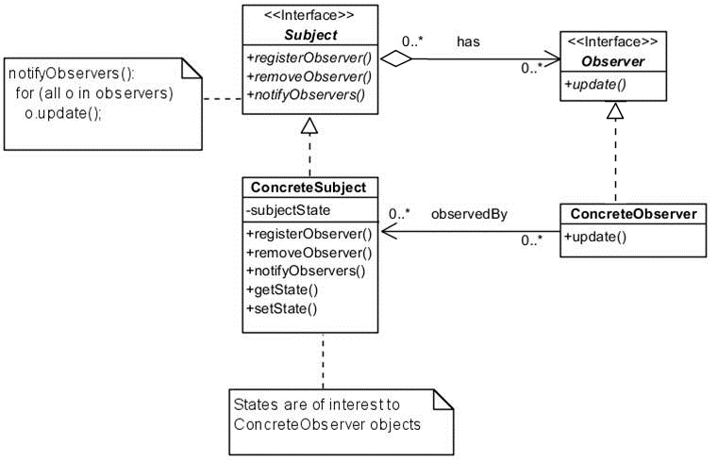
The Observer Pattern
Notes:
Here is the class diagram for the Observer Pattern. Let’s start with the || Subject, which is an interface specifying what you must implement if you want to be observed by others. The Observer pattern says that all Subjects must implement 3 methods: a registerObserver() method that adds a new observer, a removeObserver() method that removes an observer, and a notifyObservers() method that informs all observers that a change has happened. We can then have a || ConcreteSubject class, such as a YouTube channel, that implements the Subject interface. This ConcreteSubject class must therefore have their own version of register, remove and notifyObservers, but it also has all the information that is of interest to the observers, such as YouTube videos. We call the interesting information the subjectState, and the ConcreteSubject will have getters and setters for each subjectState.
Next, let’s look at the Observers. All potential observers need to implement the || Observer interface. This interface has just one method called update(), and any class that wants to observe the Subject must implement it. We call such classes || ConcreteObservers, and their update() method contains the code that runs whenever the Subject notifies its observers of a change. But first, they must register themselves with the ConcreteSubject using the registerObserver() method. In the YouTube example, your YouTube account would be a ConcreteObserver. Therefore, each ConcreteSubject will maintain a collection of Observers, and when it wants to notify its observers of a change, all it does is || call the update method for all its registered observers.

Slide 10
Key Participants
Subject
Provides interface to register/remove/notify observers
Observer
Defines interface for update notification
ConcreteSubject
Object being observed
Sends notification to observers when state is changed
ConcreteObserver
The observing object
Implements Observer interface’s update() method
Notes:
So the Observer pattern has 4 key participants. The || Subject is an interface that specifies methods to register and remove observers, and also to notify observers to update themselves. Objects will use this interface to register as observers and also to remove themselves from being observers.
|| All potential observers need to implement the Observer interface. This interface just has one method, update(), that gets called when the Subject’s state changes.
A || ConcreteSubject implements the Subject interface. In addition to the register, remove ad notifyObserver methods, it also contains all the interesting data that observers want to know about, which we call its states.
Finally, a || ConcreteObserver can be any class that implements the Observer interface. Each ConcreteObserver registers with a ConcreteSubject to receive updates, and it will also implement its own update() method that specifies what happens when the Subject’s state changes.

Slide 11
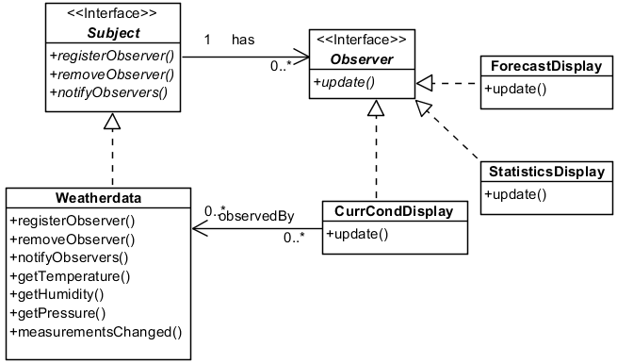
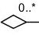
Applying Observer to Weather Station
ConcreteObserver
ConcreteObserver
ConcreteSubject
ConcreteObserver
Notes:
Back to our weather station example. We know that WeatherData is our || ConcreteSubject, because we have a whole bunch of displays monitoring it and waiting for a change so that they can update themselves. According to the design pattern, this means that WeatherData has to implement the || Subject interface, so it needs to provide implementations for the registerObserver(), removeObserver() and notifyObservers() methods. Meanwhile, each of our displays is a || ConcreteObserver, and they will use the registerObserver() method to register themselves to be an observer of the WeatherData class. They must also implement the || Observer interface, which requires them to define their own update() method. In this case, each display class’s update() method will define how they will update their displays with the latest data from the weather station. Note that each ConcreteObserver has an association with the ConcreteSubject. In this diagram, we only explicitly show the association between WeatherData and CurrCondDisplay. There is also an association between WeatherData and ForecastDisplay and StatisticsDisplay, which we left out of this diagram.

Slide 12
Implementation
interface Subject {
void registerObserver(Observer o);
void removeObserver(Observer o);
void notifyObservers();
}
interface Observer {
void update(float temp, float hum, float pres);
}
Notes:
Now, let’s do some code engineering to translate the class diagram into C# code. We start with the Subject interface, which defines 3 methods. We have || registerObserver(), which takes an Observer as a parameter and adds it to its collection of Observers. We have || removeObserver(), which also takes an Observer as a parameter, and removes that Observer from its collection. Finally, we have || notifyObservers(), which just goes through all the Observers in the collection and calls their update() functions. Since Subject is just an interface, it only declares the operation signatures. We will see the implementations later when we code our WeatherData class.
Next, let’s just code the Observer interface. In our Weather-O-Rama system, our || update() method has 3 parameters temperature, humidity and pressure, so that’s how we declare it.

Slide 13
Implementation (WeatherData)
class WeatherData : Subject {
private List<Observer> observers;
private double temperature;
private double humidity;
private double pressure;
public WeatherData() {
observers = new List<Observer>();
}
public void registerObserver(Observer o) {
observers.Add(o);
}
Notes:
Now, let’s code our WeatherData class. Since WeatherData is a ConcreteSubject, it must implement the Subject interface, which we do || here. In addition, it needs to maintain a collection of observers. In our implementation, we put our observers into a || List called observers. We still have our private attributes temperature, humidity and pressure. In addition, our WeatherData constructor should now || initialize the list of observers as an empty list.
Next, let’s code the methods specified by the Subject interface. When an observer wishes to register, we simply || add it into our observer list.

Slide 14
Implementation (WeatherData)
public void removeObserver(Observer o) {
observers.Remove(o);
}
public void notifyObservers() {
foreach (Observer o in observers)
o.update(temperature, humidity, pressure);
}
public void measurementsChanged() {
notifyObservers();
}
}
Notes:
Similarly, when an observer wishes to un-register, we just || remove it from the list.
We also have a notifyObservers() method, which will go || through each observer in the observers list to call its update() method, which lets them know the latest values of our state attributes temperature, humidity and pressure.
Finally, we have our measurementsChanged() method, which is called whenever one of the weather station sensors have detected a change. In our case, we simply call || notifyObservers whenever a change is detected

Slide 15
Implementation (Displays)
class CurrCondDisplay : Observer {
private Subject weatherData;
public CurrCondDisplay(Subject wd) {
this.weatherData = wd;
weatherData.registerObserver(this);
}
public void update(double temp, double hum, double pres) {
// update values for display
}
}
Notes:
And now, let’s see how we can implement a ConcreteObserver. Here is how we would code the CurrCondDisplay class. Since it is a ConcreteObserver, it needs to || implement the Observer interface so that it can be notified of changes by the WeatherData object. It has a || reference to the object that it is observing, which in this case is called weatherData. Note that the type of weatherData is Subject, so we know that it has the register, remove and notifyObservers() methods.
In our constructor, we pass the WeatherData object, which is the Subject, as the parameter, and we || update our reference with this parameter. Furthermore, we can || register ourselves as an observer of this Subject using the registerObserver() method.
Finally, we also implement our || update() method, which takes the temperature, humidity and pressure values and updates the display accordingly. And that’s it, that’s the observer pattern implementation for our weather station problem. We would do something similar for the ForecastDisplay and StatisticsDisplay classes, and any other displays we might create in the future.

Slide 16
Push or Pull?
This is the “push” method of notification
Whenever there is an update, the Subject pushes ALL the data to all subscribers
You can also use the “pull” method
Whenever there is an update, the subject calls update() on all subscribers with no arguments
Each subscriber then retrieves the relevant information from the subject
Notes:
The way we have written our code uses what is known as the “push” method of notification. Using this method, whenever there is an update, the Subject sends all its states to all observers. The disadvantage of doing so is that, if there is a display that does not require all the state information, then that display is receiving information that it does not need.
The alternative is to use the || “pull” method of notification. For the “pull” method, whenever there is an update, the Subject still calls the update() method for each observer, but the update() method has no parameters, so the state values are not pushed onto the observers. Instead, each observer’s update() method will access the ConcreteSubject and retrieve (or “pull”) the data that it needs. This means that each ConcreteObserver does not receive data that it does not care about, but it does require an extra step. Depending on the system you are coding, you can use either the push or pull method, whichever is more appropriate.

Slide 17
What Have We Achieved?
Subject does not know the details of observers
It only knows that all observers implement an interface
We can now add new types of Observers (e.g., a new weather display) without affecting the Subject
Since subject and observers are decoupled, we can add and remove observers at runtime
Principle: "Strive for loosely coupled designs between objects that interact"
Notes:
OK, so that was the Observer design pattern. What have we achieved? The main thing to note is that when we use the Observer pattern, || the subject does not know the details of the observers, and will not be affected if the observers change. All the Subject knows is that || all observers implement an interface, specifically, they have an update() method, and that’s all it needs to know. It does not have to be aware of how individual observers are implemented. With this separation, we can now || add new types of Observers, such as a new weather display, and this will not affect the WeatherData class at all. Finally, we can || now add and remove observers during runtime, which we could not do before in our original implementation.
The Observer pattern follows the design principle of || “Strive for loosely coupled designs between objects that interact. We have touched on the concept of loose coupling before. If two objects interact with each other, we call them “coupled”. If the interaction depends on knowing the internal implementation of the other object, that is considered tight coupling. In contrast, if the two objects do not need to know much about each other, that is considered loose coupling. The Observer pattern achieves loose coupling between Subjects and Observers by making sure that the objects only know what is necessary and nothing more. Subjects only need to know that Observers have an update() method. Observers only need to know that the Subject can register, remove and notify Observers. In this way, we have added lots of flexibility to add or remove observers during runtime, or even add a whole new type of observer without have it affect the Subject at all. Neat, right?

Slide 18
Summary
The Observer design pattern
Design Principle
Strive for loosely coupled designs
Next: The Iterator design pattern
Notes:
And that was the Observer design pattern, which is useful when you a one-to-many relationship where there is a bunch of objects that should be updated when something changes in one object. We also threw in another design principle of striving for loose coupling, which the Observer pattern follows.
In our next lesson, we will introduce the Iterator design pattern. In the meantime, like, share and subscribe! And wear a mask. You know, in case this video goes viral. Byee!

